Slide 1
Q4 Marketing Plan

Slide 2
PK-388XL SLR Camera

Slide 3
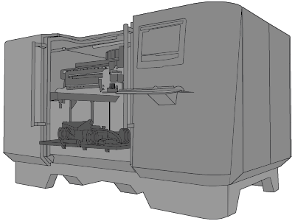
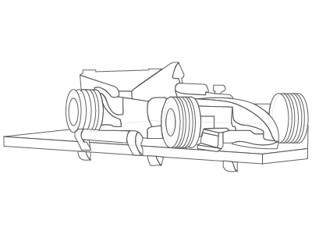
Brochure components
XT1000 3D Printer
Output image

Slide 4



Brick (#8b0033)
Kelly (#1fac59)
Navy (#000080)

Slide 5

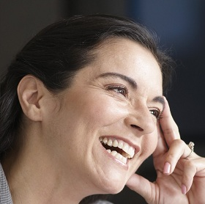
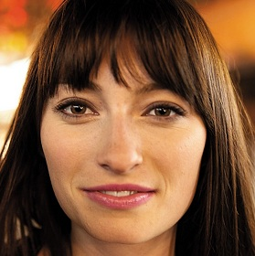
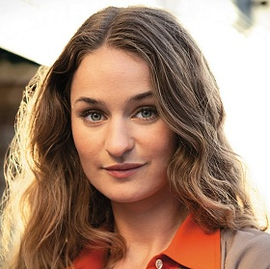


Project Team: Christie Cline Miriam Graham Adele Vance Isiah Langer Alex Wilber
Cerulean (#2956B2)

